Slide 1
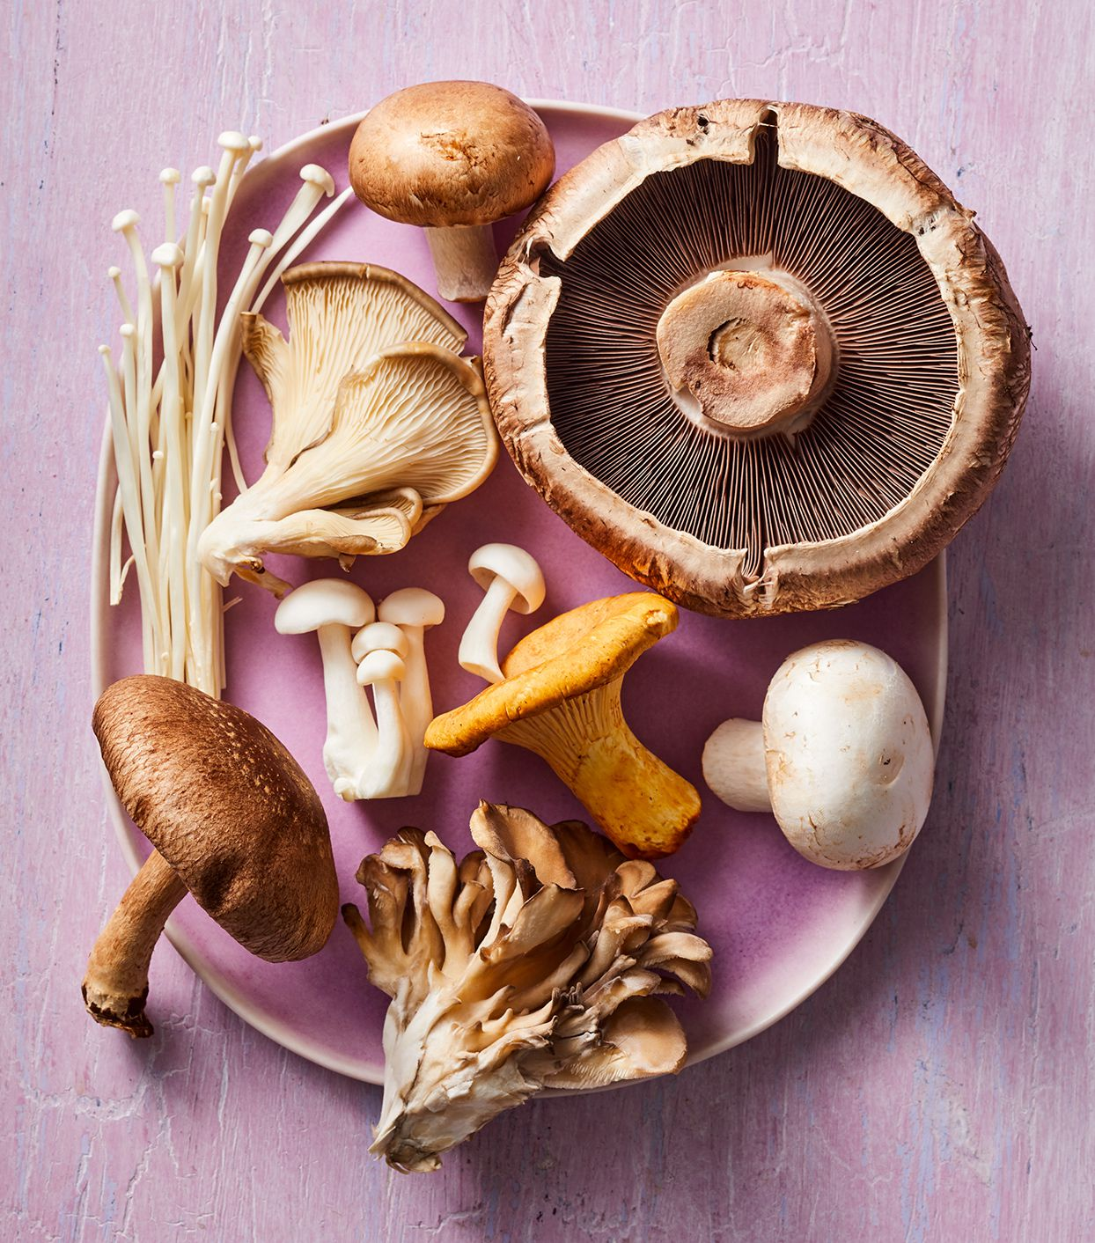
Food Freedom:Grow your own medicine
A step-by step course in cultivating mushrooms for healthy mind and body

Slide 2
Disclaimer: Liberty 101, our sponsors, and Myself do not condone the use of these methods to break any laws. this lecture is not intended for the use of growing psilocybin mushrooms

Slide 3
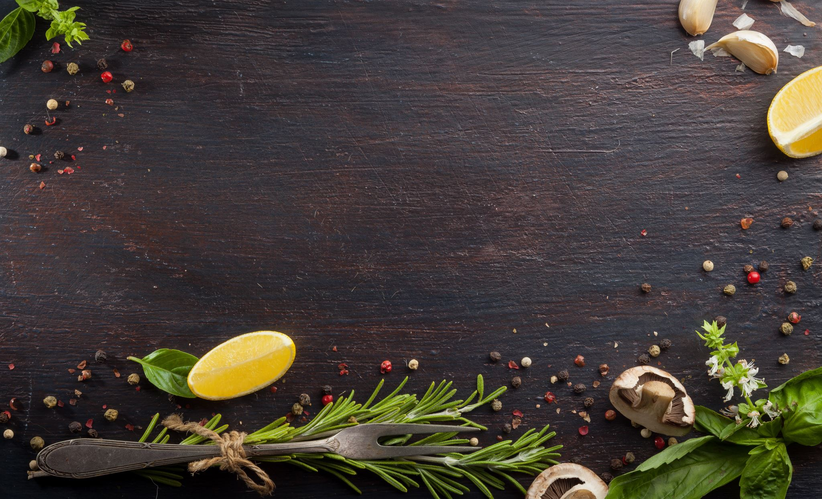
What is Food Freedom?
Food freedom is being able to grow, cultivate, and raise as much of the resources you need to provide for yourself and your family. It will help you become independent from the big corporations' prices or asking the government for permits.
Food is going the way of clothing. It is being mass harvested for the cheapest number of resources despite the quality sold to the consumer.
There’s a reason the cheapest food is the most processed and worst for you and the healthier things are expensive. This is by design! It is beneficial to big pharma and the government the more dependent you are on them. It’s easier to control people who are sick, depressed and financially restricted.
The long-term savings of growing your own food will outweigh the time and startup costs. Once you have the knowledge you can only improve and customize to your needs and household.
Create co-ops within your community. Surplus of something? Donate to your local pantry, do a potluck for those in need, or make friends with a neighbor!

Slide 4
The Power of Healing with Food
95% of your serotonin is produced in your intestine and that directly effects your hormones, autocrine, paracrine and nervous systems.
Processed and fried foods produce a short boost of dopamine, thus why these foods are so addictive.
Digestion uses up most of your body’s energy. When you intermittent fast and have good gut health your body can use that energy in other places to heal your body and support your brain health.
Poor eating habits can lead to depression, chronic fatigue, diabetes, heart issues.
Feeding your body with truly organic, fresh food gives you immune system support

Slide 5
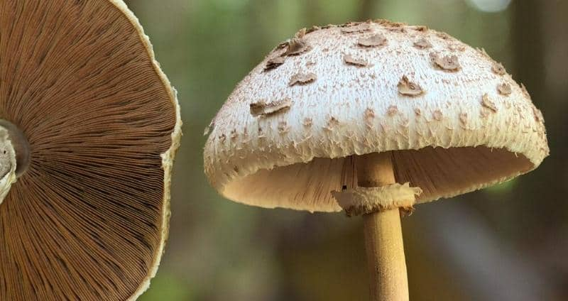

Edible Mushrooms
One the best benefits of growing your own mushrooms is knowing exactly what you are consuming. Never ingest a mushroom found in the wild without a certified guide!
Mental and physical benefits backed by scientific studies.
Many of the mushroom supplements on the market are made of something called “mycelium on grain” and are also grown cheaply and quickly. Growing your own means you get the most active ingredients in your dosage.
Most common strains: Turkey Tail – immune system support, gut health, packed with powerful antioxidants, help fight certain cancers Oyster mushrooms - reducing heart disease risk factors like high cholesterol and high blood pressure, regulate blood sugar levels, anti-inflammatory. Reishi – boost immune system, increase stamina, urinary tract health in males, Lion’s mane: boosts immunity, protects against dementia, helps with anxiety and depression Chaga: fights infections, lowers blood sugar and cholesterol Cordyceps: boosts exercise/sport performance, inflammation and heart health

Slide 6
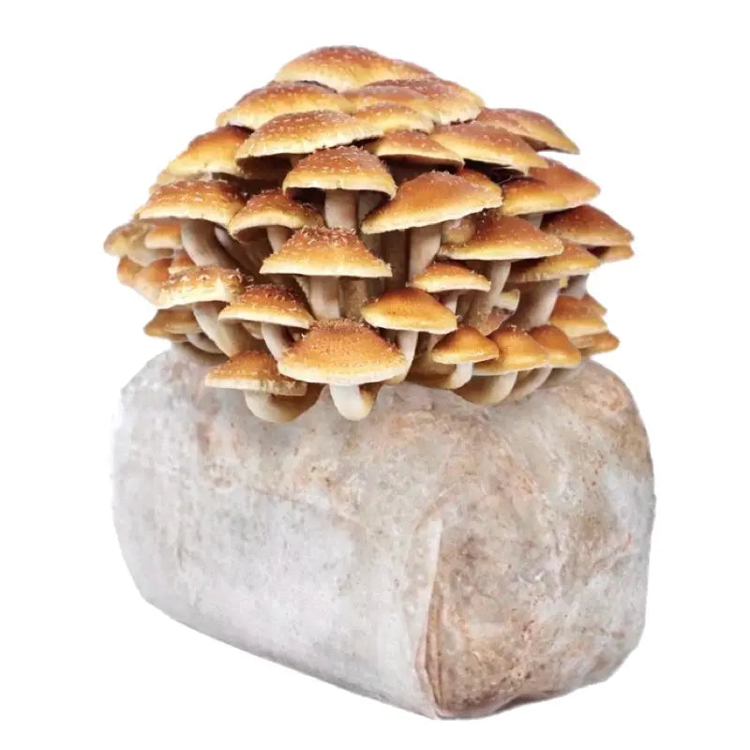
THE MUSHROOM CYCLE
STRAIN SELECTION
INOCULATION
INCUBATION
HARVESTING
SUBSTRATE PREPERATION
FRUITING

Slide 7
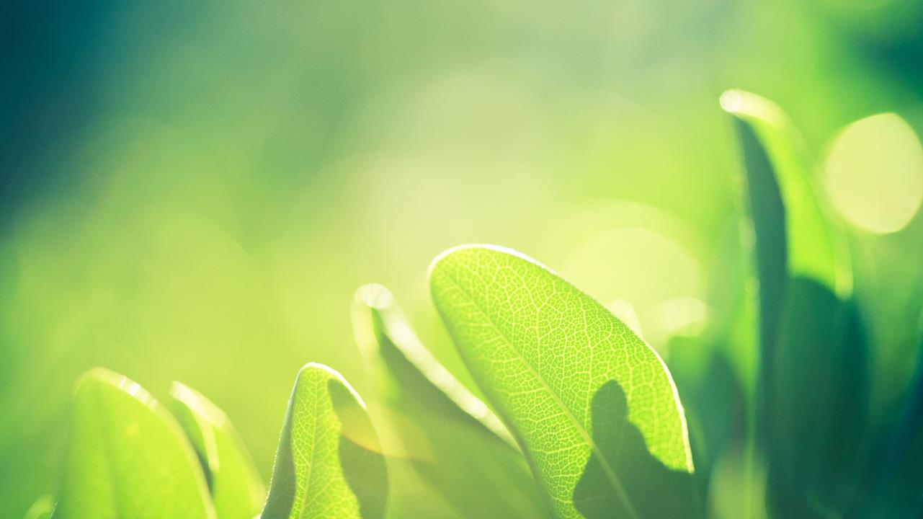
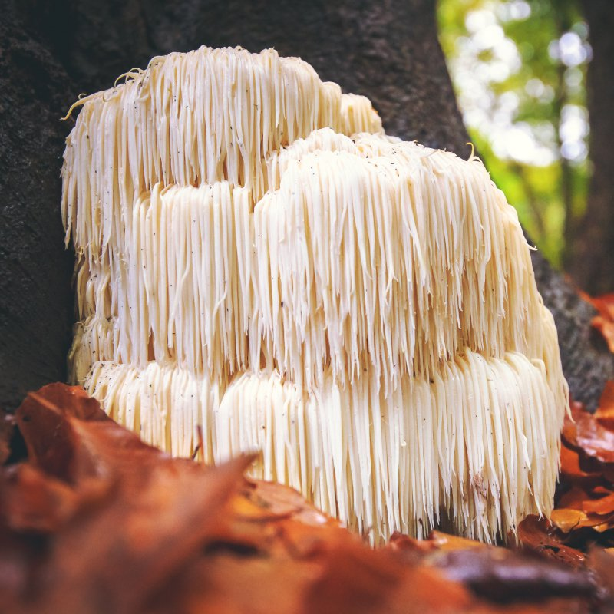
PF Tek
A mushroom-growing technique developed by a grower who used the nick-name Psilocybe Fantasticus, or PF for short
While not high yielding, it is reliable and simple thus great for beginners
Strains that do best with PF Tek:
Lion’s Mane (Hericium erinaceus), Shaggy Mane (Coprinus comatus), Several of the oyster mushrooms (Pleurotus sp.)

Slide 8
You will need: 1 XL and 1 Medium plastic clear tote with lid
Hammer, Phillips head screwdriver, power drill for air flow in tote
5 wide mouth glass jars with lids (1 for alcohol torch, 4 for inoculation)
91% + isopropyl alcohol
Seedling heating pad (optional)
Small light
Brown rice flour
Vermiculite
Perlite
Tin foil
Mushroom Spores
Pressure cooker/Instant Pot
Paper towels
Latex gloves
Cotton balls
Large mixing bowl
Measuring cup
Spray bottle
Silica gel packets

Slide 9
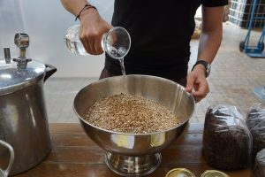
2:1:1 ratios
Vermiculite : Brown Rice Flour : Water
A mushroom substrate is a medium that allows mushroom mycelium – the vegetative part of fungus consisting of a mass of branching threads called hyphae – to develop and establish itself. The substrate offers the nutrition, moisture, and energy that mushrooms require to grow and fruit
Mixture should be a crumbly consistency but not wet
Substrate Preparation

Slide 10
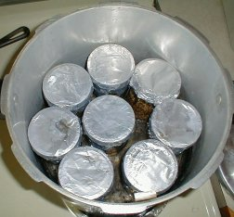
Fill jars half way with substrate mixture. Do not pack tightly. Top with light layer of vermiculite
Wrap jar lids tightly with tin foil.
Fill instant pot with 1 cup of water and place stand at bottom.
Pressure cook for 4 hours
Wash and dry jars and their lids thoroughly with antibacterial soap.
Repeat for remaining jars
Sterilization

Slide 11
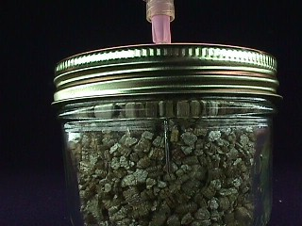
This method requires liquid spores. Recommended vendors are northspore.com and sporeworks.com
Shake syringe vigorously for 3-5 minutes to break up spores. Screw on new tip. Insert syringe into pin hole past vermiculite layer into BRF mixture. Squeeze small amount into jar. Aim for 1-2 ML each jar.
Pull syringe plunge back slightly. Hold needle over flame for 10-20 seconds until glowing. Wipe needle down with isopropyl alcohol soaked paper towel. Repeat for remaining jars.
WARNING: NEEDLE WILL BE VERY HOT. USE CAUTION
Mushroom inoculation involves bringing the spawn into contact with the substrate to initiate its growth and development.
Repeat for remaining jars. Once finished place jars in dark cool place for 3-4 weeks until cake is completed covered in mycelium.
Inoculation

Slide 12
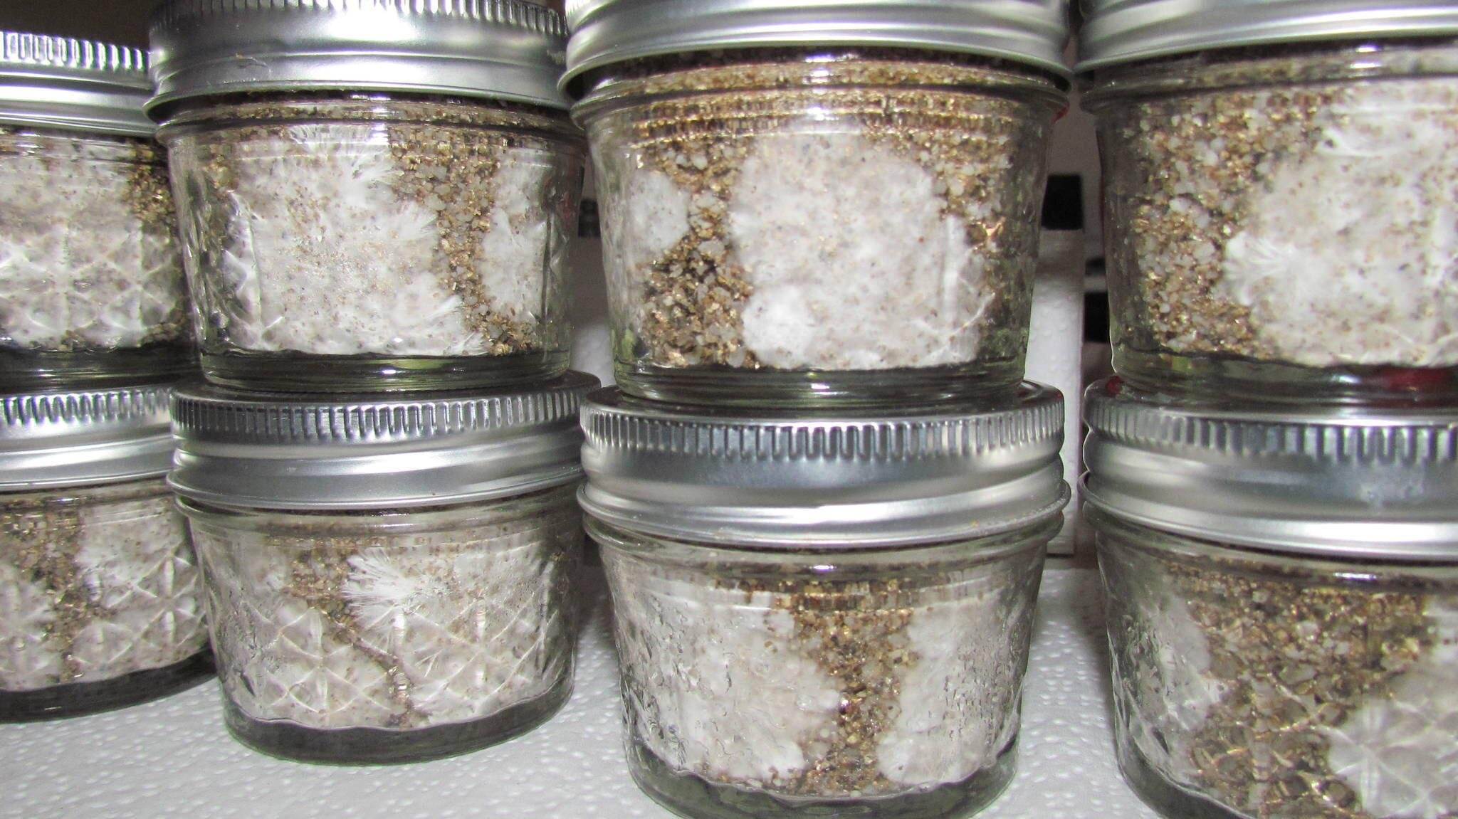
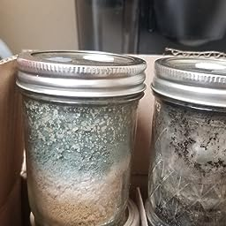
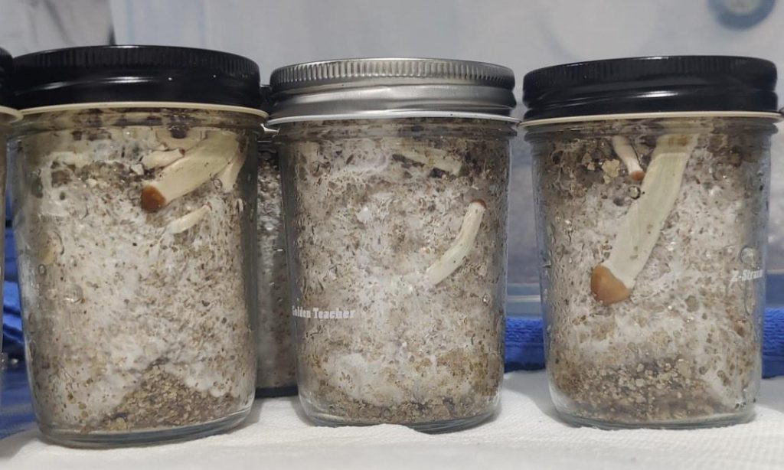
Stages of Mycelium
Signs of contamination/mold. Pour isopropyl alcohol through holes in lid before opening to avoid mold spore contaminating air and work space.

Slide 13
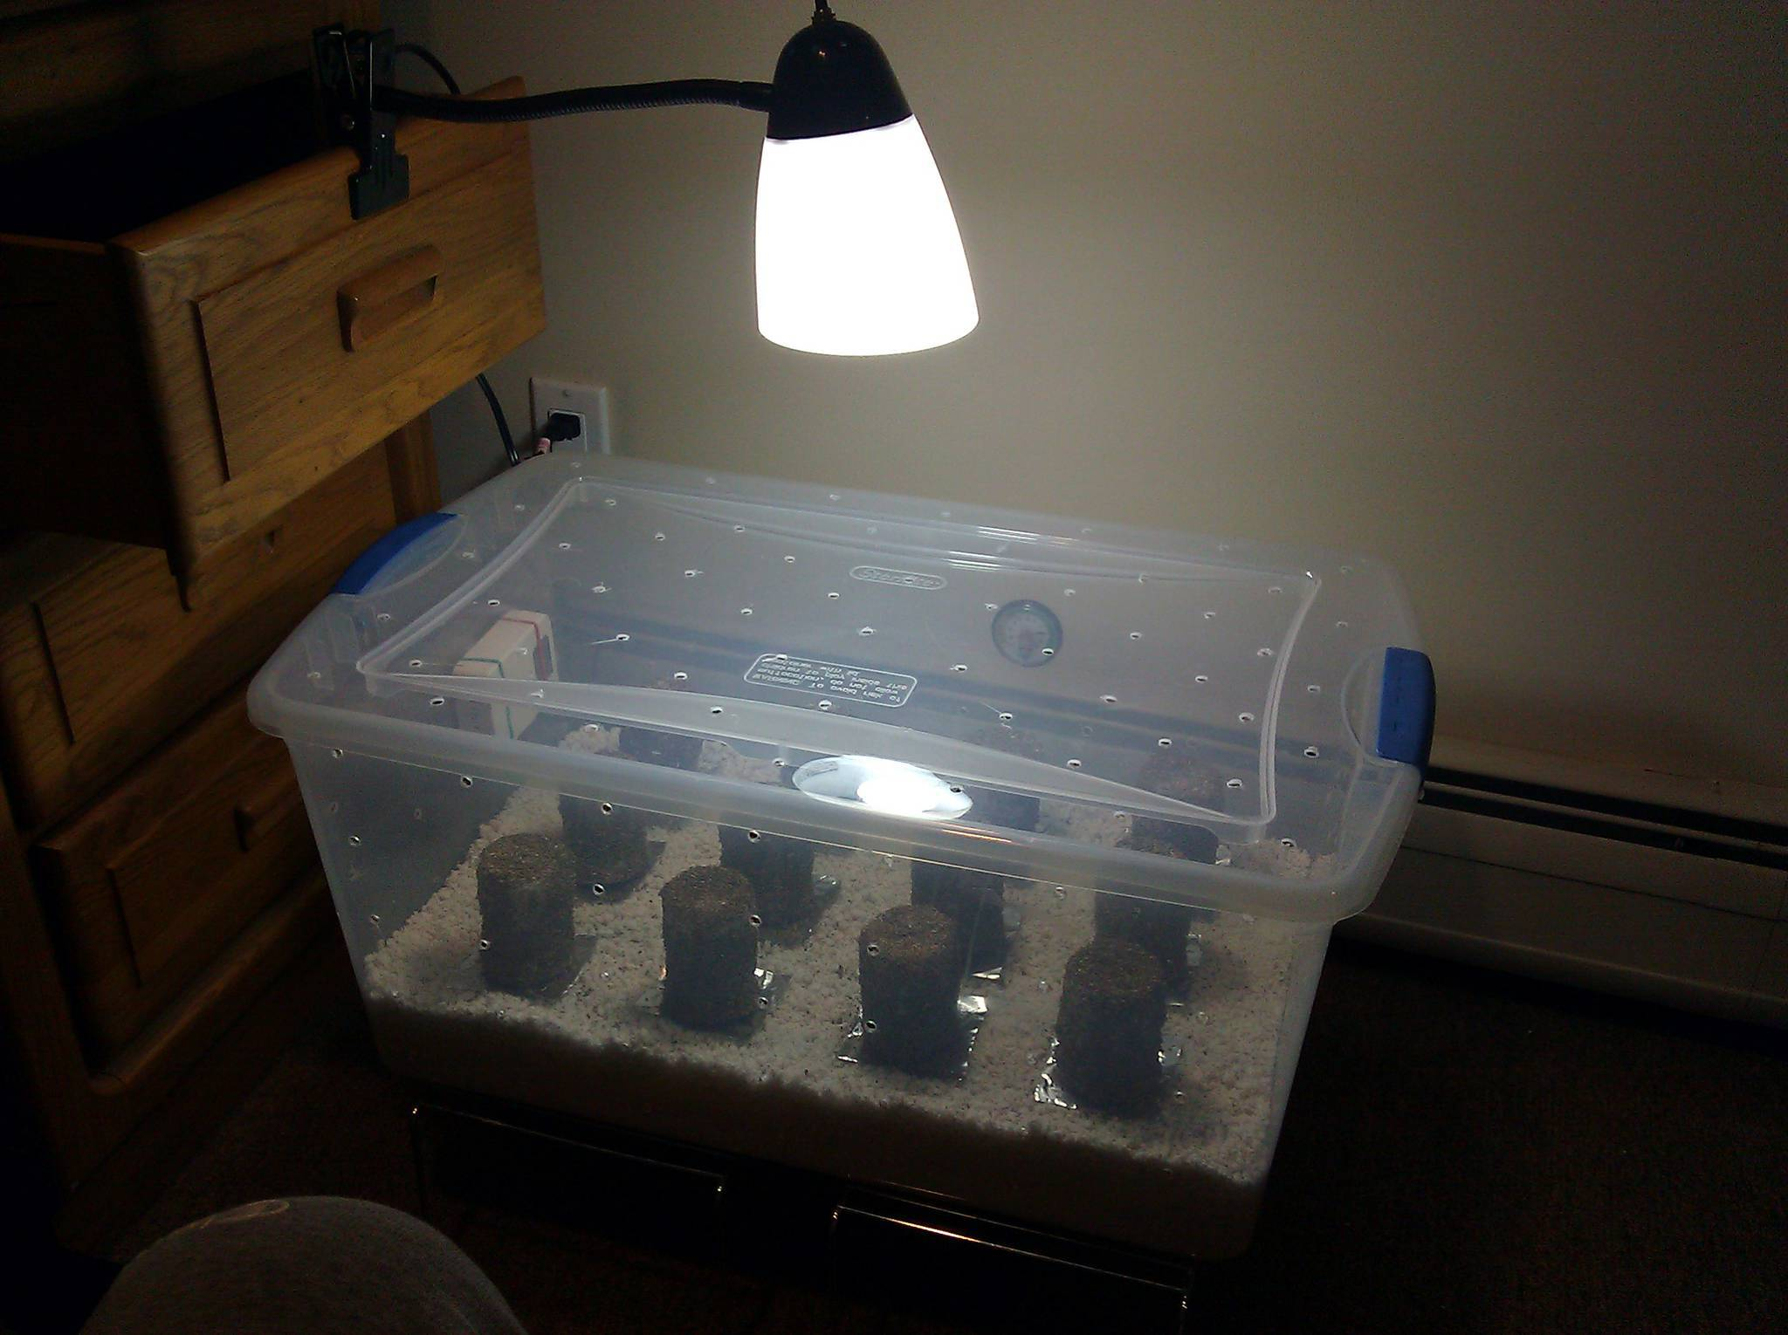
Mushrooms like humidity and moisture, spray sides of terrarium when they get dry. If cakes look dry, bruised, or fruiting is slow, you can place a small amount of vermiculite on the top of the cake and soak with water.
Fan the mushrooms every 4-6 hours, the more the better.
Use a heating grow pad to keep humid. If your terrarium is drying out quickly, pull light source back or remove heating pad.
Watch for mold. Remove cake immediately if any signs appear to help keep from contaminating rest of cakes.
Simulate sun cycle by keeping light source 12 hours on, 12 hours off. Use a timer switch or set alarms on your phone. Using a non halogen bulb that doesn’t emit much heat will help keep chamber from drying out.
Incubation

Slide 14
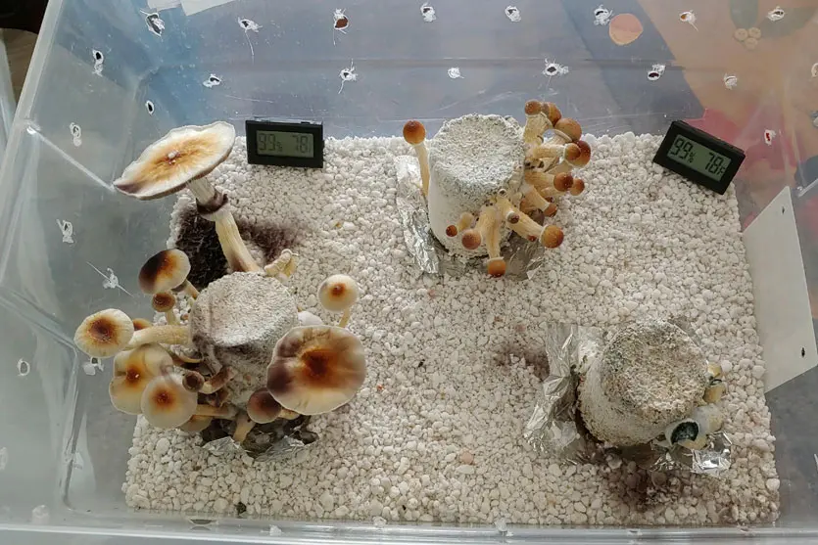
Some varieties of mushrooms are at the most potent when picked just before “veil” is broken, fully open to reveal gills under cap, and or when they feel sponge-like.
Pull entire cluster off. Soak cakes for 24 hours and repeat incubation steps until cake no longer fruits.
The fruiting body is the part that grows out of the tree or ground and can be harvested. This process can take 1-3 weeks depending on strain.
Fruiting

Slide 15
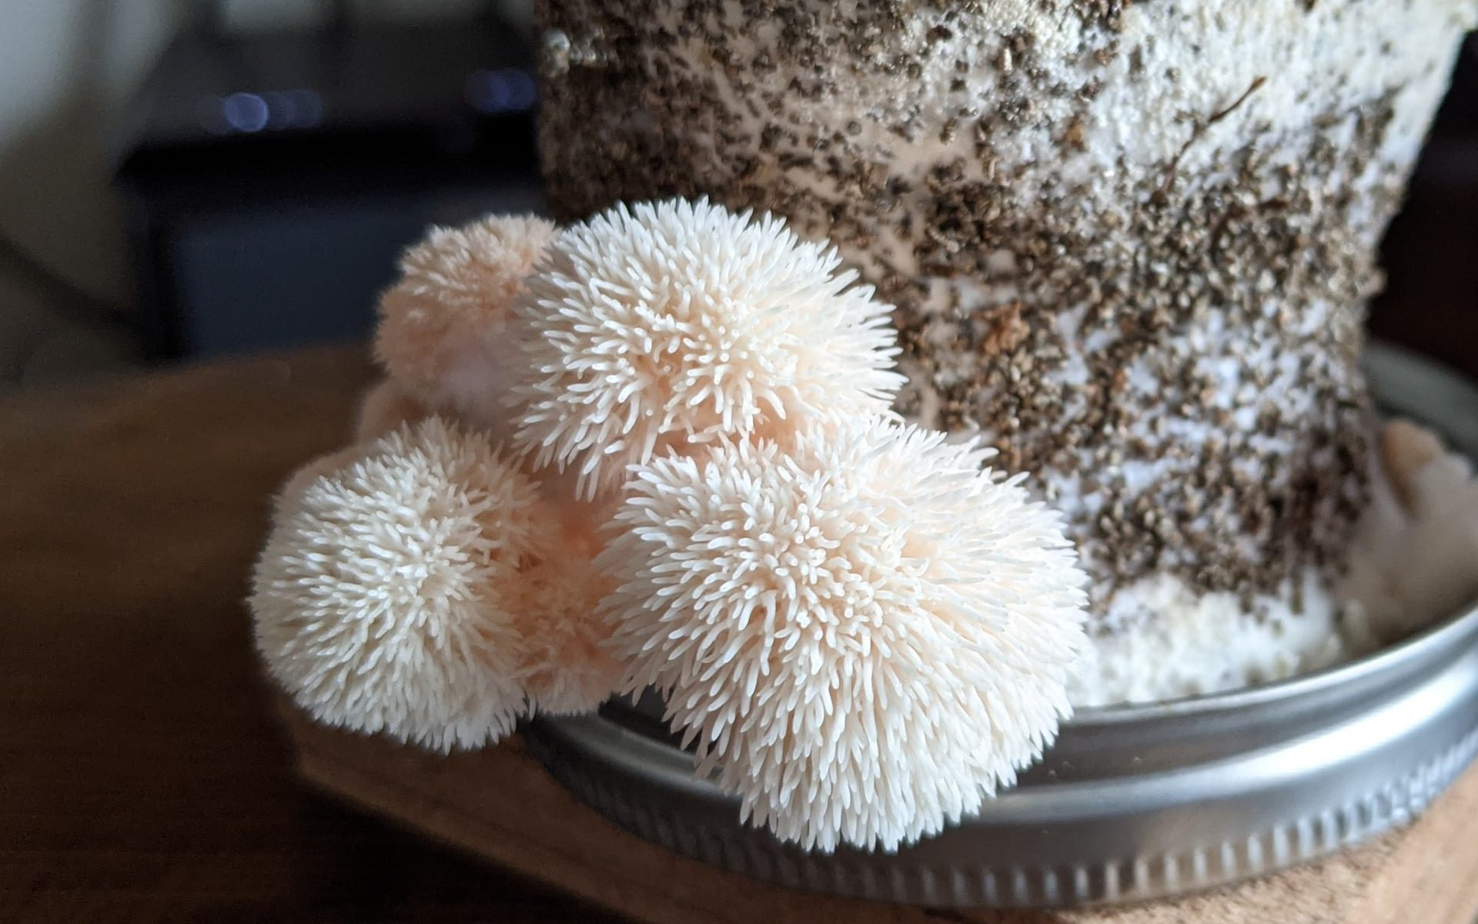
Fruiting bodies

Slide 16
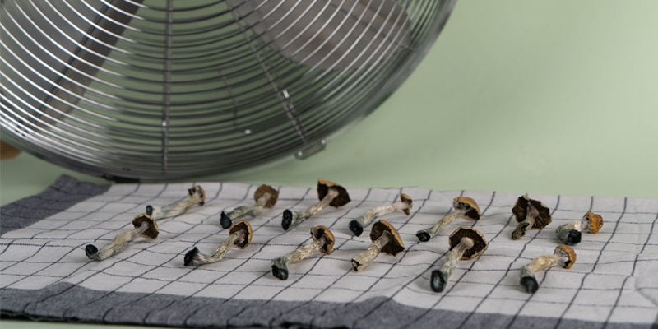
Dry out in small box with silica gel packets, small fan, or dehumidifier.
Keep dried mushrooms in airtight container away from direct sunlight. Some strains can be kept in the freezer if sealed properly.
Mushrooms should be “cracker dry” and break easily when snapped apart at stem or cap.
Harvesting

Slide 17
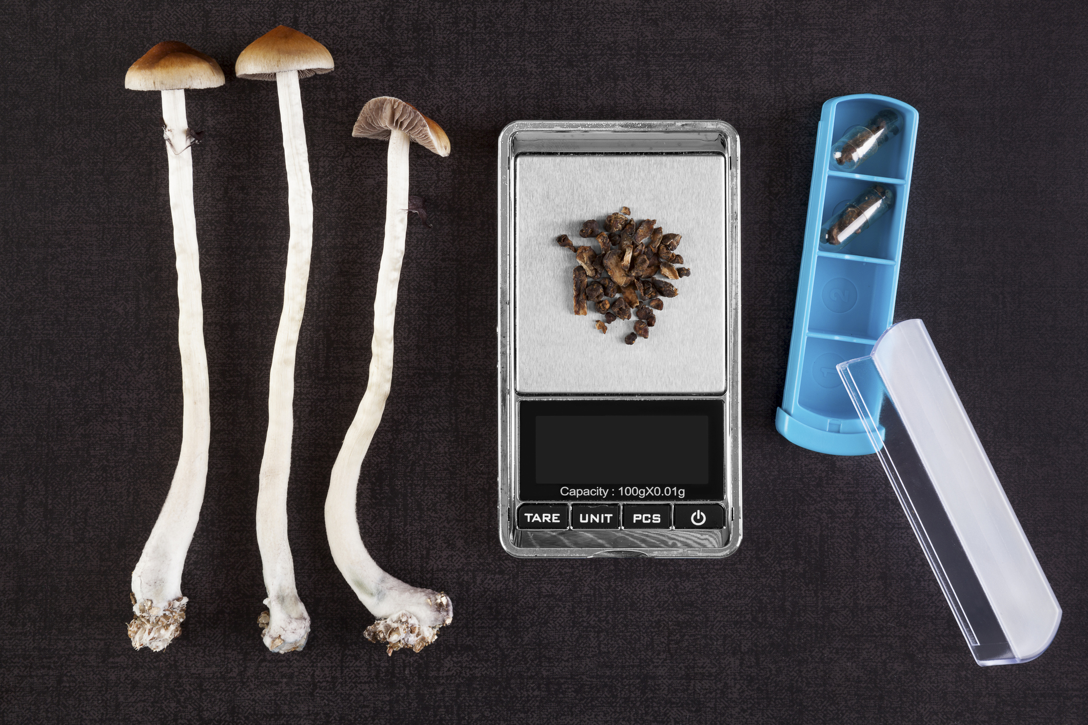
Consumption
Most recommended dosages are in dried grams. Use a kitchen scale that can weigh milligrams for accuracy and tracking.
Finely grind your blend of mushrooms. You can add this to smoothies, juices, coffee, or encapsulate to take as a supplement. Some mushrooms can be consumed raw if cleaned and prepared correctly.
Once again, NEVER eat a mushroom you find in the wild. Some species are deadly or can produce uncomfortable side effects.

