Slide 1
WHO OWNS YOU?
An Explanation of Libertarian Principles

Slide 2
If you don't own yourself completely, who else owns you?

Slide 3

Self-Ownership
The belief that every person has exclusive ownership and control over your body, your mind, and the fruits of your labor. Anything less is slavery.

Slide 4
“We hold these truths to be self-evident, that all men are created equal, that they are endowed by their creator with certain unalienable Rights” - Declaration of Independence

Slide 5
What Are Rights?

Slide 6
Natural Rights
Characteristics which exists as a consequence or our humanity
Not dependent on laws or customs, they exist without permission
Cannot be separated from you regardless of law or force

Slide 7
What Are Your Rights?
LIFE
LIBERTY
PROPERTY
Your Existence
Your Thoughts and Actions
The Fruits of Your Labor

Slide 8
What is Law?
Law is the collective use of force to achieve political or social goals
The only justifiable use of force in a free society is for the DEFENSE of the individual right to life, liberty and property.
If an individual cannot legitimately interfere with another’s right to life, liberty or property, neither can a group of people acting together – even if they make a law that says they can

Slide 9
Law of Liberty
The state of being free within society from oppressive restrictions imposed by authority on an individual’s right to life, liberty and property
The only proper role of law is to protect the rights of individuals.

Slide 10
Voluntary Society
The only legitimate law is one that protects the individual right to life, liberty and property
The law may not prohibit someone from any action which does not violate the right of another’s life, liberty or property – no such thing as a “victimless crime”
The law may authorize the taking of property from anyone who does not voluntarily agree to give it – “taxation is theft”

Slide 11
What is a Libertarian
The Non-Aggression Principle:
The only legitimate use of force is in defense of an individual’s right to life, liberty and property, therefore we reject the initiation of force as a means of achieving political or social goals.

Slide 12
The Right to Keep and Bear Arms
There can be no freedom without the ability to defend yourself.

Slide 13
What are Gun Rights?
A man with a gun is a citizen. A man without a gun is a subject. – Rep. Allen West
A man’s rights rest in three boxes: The Ballot Box, The Jury Box, and the cartridge box. –Frederick Douglass
Notes:
https://en.wikipedia.org/wiki/Foreign_policy

Slide 14
What are Gun Rights?
“God Created Men and Sam Colt Made Them Equal!”
–Old West Adage
"One man with a gun can control 100 without one."
–Vladimir Lenin
Notes:
https://en.wikipedia.org/wiki/Foreign_policy
You right to gun ownership as a collective to prevent tyranny by government and individually to protect your individual rights to defend yourself.
The gender gap of physical force is equalized by guns

Slide 15

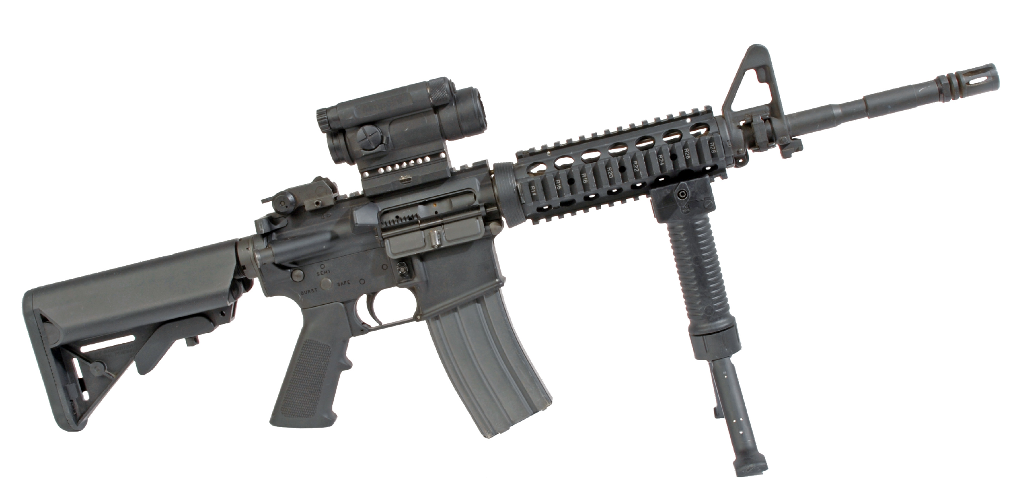
What are Gun Rights?
Gun rights are very simple. You have the right to own any weapon, without justification. Merely owning a thing should never be a crime, and should require no justification.
Notes:
https://en.wikipedia.org/wiki/Foreign_policy

Slide 16
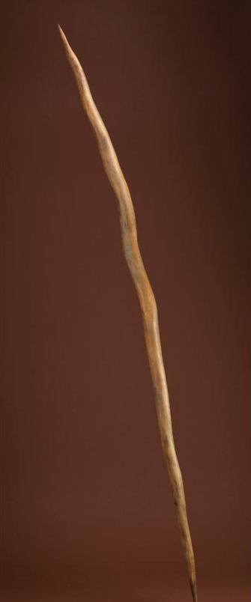
Brief History of Weapons
400,000 BC
The earliest evidence of humans using spears, in a part of Germany now near Schöningen
Notes:
https://en.wikipedia.org/wiki/Foreign_policy

Slide 17
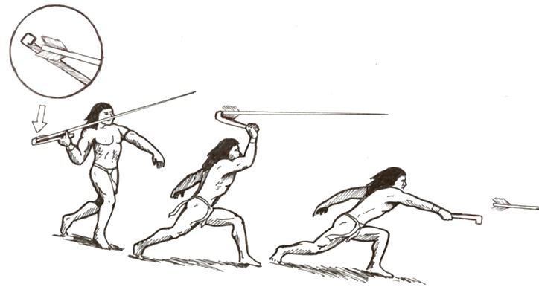
Brief History of Weapons
40,000 to 25,000 BC
The atlatl, sometimes dubbed the Stone Age Kalashnikov, throws a flexible dart that can kill a deer at 40 meters. Developed in northern Africa, it spreads throughout the world, being later replaced by the bow and arrow.
Notes:
https://en.wikipedia.org/wiki/Foreign_policy

Slide 18
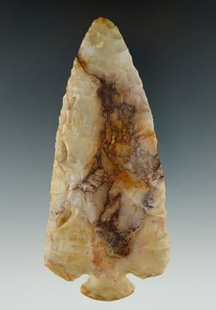
Brief History of Weapons
20,000 BC
The earliest arrowheads date from this time, suggesting that bows and arrows were in use.
Some believe they were invented much earlier, pointing to a single 60,000-year-old stone that may or may not be an arrowhead.
Notes:
https://en.wikipedia.org/wiki/Foreign_policy

Slide 19
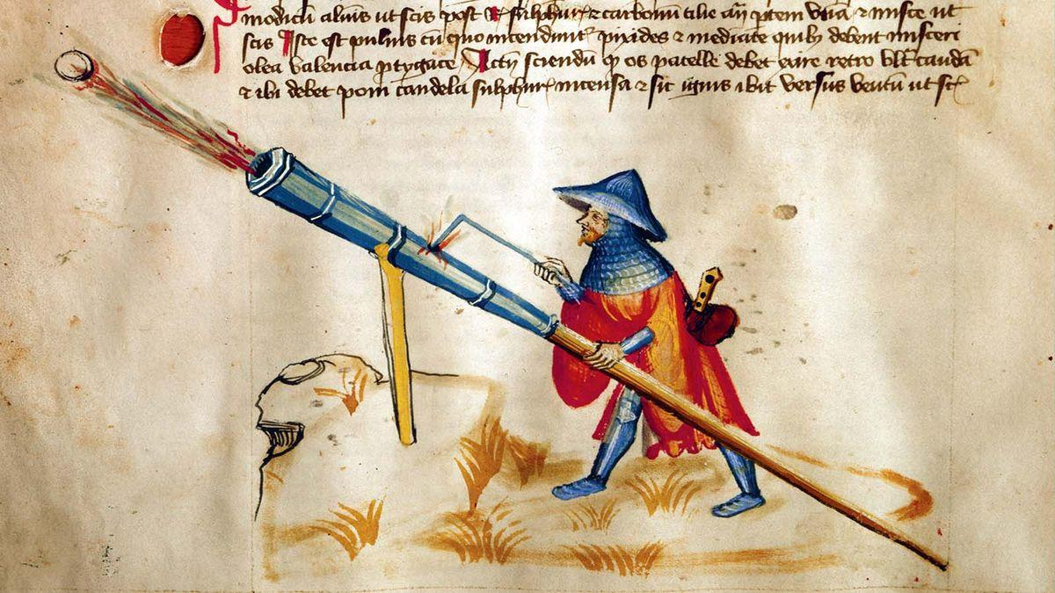
Brief History of Weapons
800 to 1300 AD
Gunpowder is invented in China. This leads rapidly to a primitive firearm, the “fire lance”, the first rocket, known as the “fire arrow”, and primitive bombs under the Song Dynasty (960 to 1279) – new technology partly driven by aggressive neighbors like the Jin Dynasty to the north.
Notes:
https://en.wikipedia.org/wiki/Foreign_policy

Slide 20
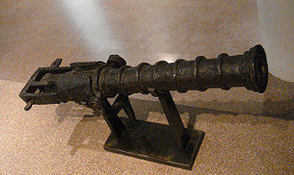
Brief History of Weapons
1368 to 1644
China’s Ming Dynasty drives firearms technology forwards. Developments include the matchlock, which eliminates the need to fire a gun with a hand-held match; the musket; and the naval mine. The dynasty’s new technologies are eventually collected in the Huolongjing: a treatise on warfare by Jiao Yu and Liu Ji.
Notes:
https://en.wikipedia.org/wiki/Foreign_policy

Slide 21
What’s the point?
Weapons are as old as society itself.

Slide 22
Historic Examples of Gun Control Advocates

Slide 23
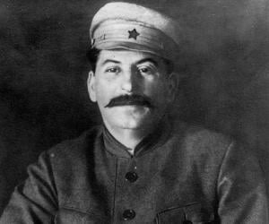
Joseph Stalin
In 1929 the former Soviet Union established gun control and as a result Stalin's government killed 40 million Soviets.
Notes:
https://en.wikipedia.org/wiki/Foreign_policy

Slide 24
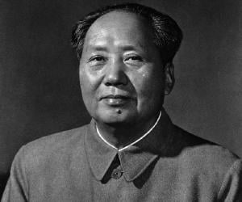
Mao Zedong
“All political power comes from the barrel of a gun. The Communist Party must command all the guns; that way, no guns can ever be used to command the party.”
The quote was from Mao Zedong, founder of Communist China. Mao’s first act after gaining complete control of China in 1949 was to take away all guns from the population. It was a policy he began in 1935 as he took over each rural province. Anyone found with a gun post-confiscation was executed.
An estimated 65 million Chinese died as a result of Mao’s repeated, merciless attempts to create a new “socialist” China. Anyone who got in his way was done away with—by execution, imprisonment, or forced famine.
Mao killed more people than either Stalin or Hitler during World War II. And it all began after he took away the guns.
Notes:
https://en.wikipedia.org/wiki/Foreign_policy
(Konstantine- let's make this slide less wordy and surely discuss the content .
This is great for the talk. We need to shorten the weapons part though :D;) (We can use those slides for content distribution.)

Slide 25
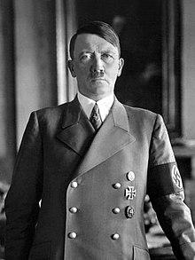
Adolf Hitler
In Germany, Jewish extermination began with the Nazi Weapon Law of 1938, signed by Adolph Hitler, that required police permission of ownership of a handgun. All firearms had to be registered. Germans who enjoyed using bolt-action rifles for target practice were told to join the Wehrmacht if they wished to shoot "military" rifles.
The Nazis also enacted the "Regulations against Jews' possession of weapons" within the days of Kristallnacht-the "night of broken glass"-when stormtroopers attacked synagogues and Jews throughout Germany.
Firearms registration lists, moreover, were used to identify gun owners. When the SS arrived, more than the gun would disappear. The owner would never to be seen again. These policies were promulgated in every country conquered by Hitler, and with the same results.
Notes:
https://en.wikipedia.org/wiki/Foreign_policy
This slide is too wordy . the content is great
Maybe all these are on one slide and it is discussed mostly

Slide 26
What’s the point?
Gun Control is a Dictator’s Best Friend

Slide 27
Historic Examples of Gun Control in the United States.
A Florida statute enacted in 1825 empowered white citizen patrols to “enter into all Negro houses and suspected places,” search for weapons, and “lawfully seize and take away all such arms, weapons, and ammunition.”
In 1831, the Maryland legislature passed a law banning free Black residents from carrying arms.
The Tennessee constitution — which had formerly guaranteed gun rights to “the freemen of this State” — was amended in 1834 to restrict those rights only to “the free white men of this State.”
After the Civil War, racists continued to use gun control as a tool of white supremacy. A common provision of the postwar Black Codes adopted by Southern states made it illegal for the freedmen to possess firearms. To enforce those laws, white men assembled posses to intimidate Black communities in the South and ensure they weren’t armed. The most notorious of those gun-control posses called itself the Ku Klux Klan.
Notes:
https://en.wikipedia.org/wiki/National_security

Slide 28
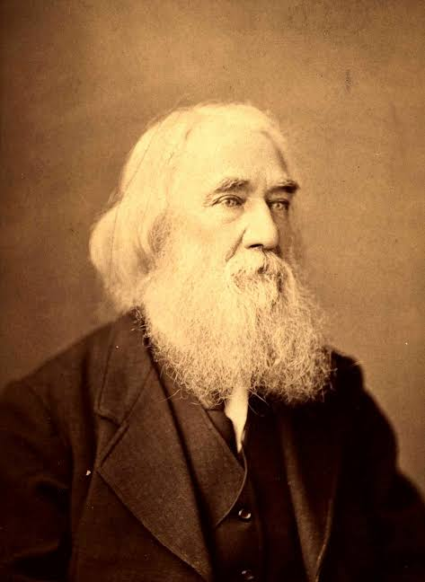
Lysander Spooner
Lysander Spooner, argued that ratification of the Second Amendment had made slavery itself unconstitutional. “This right of a man ‘to keep and bear arms,’ is a right palpably inconsistent with the idea of his being a slave,” wrote Spooner in 1860. The constitutional right to keep arms, he pointed out, “implies the constitutional right to use them, if need be, for the defense of one’s liberty or life.”
Notes:
https://en.wikipedia.org/wiki/Foreign_policy
Can we summarize this ?

Slide 29
Conclusion
Firearm ownership is merely an evolution of the spears that our species started with over 400,000 years ago.
Governments always use weapon restrictions against their citizens.
Firearm ownership levels the playing field between oppressor and the oppressed.
Without the presence of weapons, protesting is merely whining.

Slide 30
The Libertarian Perspective On Criminal Justice
How libertarian ideas can improve law enforcement
Notes:
Bryan

Slide 31
Libertarians understand that security is a vital service necessary to a free and prosperous society.
Notes:
As libertarians we believe that all services are best provided privately through a free market system that allows for competition and accountability.
We also understand that no matter how capable we are of protecting ourselves and our property sometimes this service has to be outsourced.
So Today we’re going to talk about two of the ways this service is provided, why one is preferable to the another and some ways we can work within the system we have to improve the outcome

Slide 32
Security vs policing

Slide 33
Policing is a system of controlling a population through force based on rules created by people far away who you may have never met or even share values with
Notes:
Because this system lacks competition between providers it comes with all the negative outcomes associated with monopolies in other industries

Slide 34
Poorly trained employees
Service providers whose revenue is not based on their ability to provide a good service
And a lack of accountability for corruption or failing to carry out their duties
Notes:
Expand on each
1 im sure we have all seen or experienced poorly trained officer escalating a situation needlessly,failing to properly subdue a suspect or even pulling there firearm instead of there taser and unintentionally killing someone
2 despite whether a department does a bad job or is filled with corruption they still get funded
and a significant amount of that funding often times comes directly from you through enforcement of arbratery statutes like speed traps and code violations
3 Because this may be the most important and dangerous aspect of this system today we’re going to talk about an alternative as well as how we can protect ourselves and maybe make the system a little better

Slide 35
Security is a service where one or more people can be granted the authority to protect the rights of others in a given location or situation.
Notes:
This is generally provided by private companies that have to compete for the privilege to provide this service for a profit
For example a bar or a concert venue will hire security to ensure that you are not robbed, assaulted, or defrauded, while in their establishment
But a bouncer can not put you in a cage just because someone in washington doesn’t approve of your choice of recreational substances

Slide 36
A security companies reputation is dependent on the quality of its employees
Its revenue is based on its ability to compete with other service providers
Violating your rights or failing to do their job can result in civil or criminal prosecution
Notes:
This means A security company operating in a free market has an incentive to hire and train the best people
Which means Such a company must maintain a good relationship with the community in order to be allowed to operate within it
For example If a security guard at a concert was to unnecessarily assault you during the execution of his job, or simply stand by and watch as you were beaten by another customer he would be subject to civil or criminal liability and his company may not be hired in the future as a result
Since our current system of policing fails in these areas its good to understand how police operate and how we can protect ourselves while working to make things better

Slide 37
How do police avoid liability?
Notes:
There are 2 main way this is achieved

Slide 38
Qualified immunity
This is a policy that shields law enforcement from individual liability unless they clearly violate a constitutional right
Notes:
So Imagine a healthcare system where a dr or surgeon was not held responsible for giving you the wrong treatment or leaving a tool inside you while operating
Instead they are required to hold liability insurance so that you may be compensated for any mistakes they might make
Most industries operate in this manner For example i as a home improvement contractor am required to insure myself and my work.
if i were to build you a second story deck but fail to properly attach it to you home and the first time you have a party the whole thing came crashing down
i would be held personally responsible for the physical or financial loss the customer received as a result
if i were to repeat this mistake in a free market setting i would eventually find it hard to stay in business as people would choose not to hire me
Similar to the way you can file for malpractice if a doctor fails do do their job in a safe manner and choose your doctor based on weather he has been sued or not in the past
In contrast if the police rip the front of your house off with a tank in some sort of drug raid only to find out they have the wrong address generally you will simply be left with an im sorry at best
And police officers who fail to do their job or harm someone in the process are often shuffled off to other departments unbeknownst to the public further creating an unsafe environment for you the consumer

Slide 39
Subversive tactics the police use to violate your rights.
“Where are you coming from/where are you going”
Trick you into participating in an unconstitutional investigation into your life
Try and insert probable cause into a situation where there may not otherwise be any.
Notes:
Another way police avoid liability is to use subversive tactics to violate your rights
If you have ever been pulled over you may remember one of the first questions you were asked was where are you headed or where are you going
This may seem like simple small talk but to be clear it is not.
This is a deliberate psychological tactic designed to do two things.
(refer to slide)
Suppose you answer that you were hanging out with a friend on 25th street, this seems innocent enough. Hanging out with your friends is not illegal…
But the officer may respond that he knows of multiple drug dealers that operate on 25th
and if it happens to be late at night he may see that as reasonable cause to search you.
If you are then caught with anything illegal, whether purchased on 25th or not, a judge may agree with the cops assessment of probable cause and uphold the charges.

Slide 40
What can you do.
Only give out information that is required and pertains to the situation at hand
Working to change policies like qualified immunity and pushing to require officers to hold liability insurance
Notes:
Obviously you are required to identify yourself and show paperwork during a traffic stop but again you dont have to tell the officer everything you have been doing that day
Understand that you have very little power in this situation.As I’m sure you have all see the video of the guy screaming about his rights as he is drug out of his car and tased.
But understanding their tactics and protecting your rights can provide you the opportunity to regain your power when you have your day in court.
There are no shortages of incidents where illegal things have been found on a person but failing to give the officer unnecessary information has lead to a judge deciding that the cop did not have probable cause to search you and leading to the charges being dropped.
These changes are just a couple of the many realistic goals that can make a bad system a little better for everyone
this would go a long way to holding officers accountable if they abuse their power or fail to do their job correctly

Slide 41
In conclusion
Free market based security is preferable to single payer government policing.
Knowing the tactics that police use and how to protect your rights is your best defense.
And fighting to repeal policies like qualified immunity and requiring police officers to hold liability insurance are just a couple way to make a terrible system a little better .
Notes:
Thank you all for listening we will now hear from ___________

Slide 42
MEDICAL FREEDOM
My body, my choice!
Notes:
Medical Freedom is the freedom to choose what foods, nutrients, medical procedures, and medical treatments you have without coercion or force.

Slide 43
Medical Freedom
An individual’s right to make any medical choice, in any situation, no matter what
Pertains to all medical treatments
There is a proposed 28th Amendment to the US constitution
Notes:
Simply put, medical freedom is an individual’s right to make any medical choice, in any situation, no matter what.
Proposed 28th Amendment to the United States Constitution
The Medical Freedom Amendment
Statement of the Amendment
"All people have the Right to secure their Health in the manner they choose. Congress, the President, State Legislatures and Executives, Governmental Agencies or Departments shall make no law or executive order that impedes the Individual's rights to informed consent nor right to medical choice nor freedom of medical choice. Nor shall the President, Congress, State Legislatures and Executives, Governmental Agencies or Departments make any law or executive order that impedes the Individual's right to medical privacy and freedom without individual and specific judicial warrant supported by Oath and affirmation of necessary cause to protect Society from Harm describing the Individual's condition and danger it presents.

Slide 44
Bodily Autonomy
The right for a person to govern what happens to their body without threat of or use of violence/aggression and/or threat of negative consequences
What constitutional amendment gives us this right?
What natural law concept gives us this right?
Did the forcing and coercing of COVID vaccines and biologics violate this right?
Notes:
As conscious sovereign beings we have the ultimate say in what happens to our bodies and the state or other people have no right to force or coerce anything that affects the sanctity of our physical bodies.
Bodily autonomy is about the right to make decisions over one’s own life and future.
Two Amendments apply to the mishandling of the Pandemic
Fourteenth Amendment
Tenth Amendment
Fourteenth Amendment Explained
Section 1
All persons born or naturalized in the United States, and subject to the jurisdiction thereof, are citizens of the United States and of the State wherein they reside. No State shall make or enforce any law which shall abridge the privileges or immunities of citizens of the United States; nor shall any State deprive any person of life, liberty, or property, without due process of law; nor deny to any person within its jurisdiction the equal protection of the laws.
Covid pandemic mandates and policies violated these constitutional rights.

Slide 45
Fourteenth Amendment
Section 1
All persons born or naturalized in the United States, and subject to the jurisdiction thereof, are citizens of the United States and of the State wherein they reside. No State shall make or enforce any law which shall abridge the privileges or immunities of citizens of the United States; nor shall any State deprive any person of life, liberty, or property, without due process of law; nor deny to any person within its jurisdiction the equal protection of the laws.
Notes:
Fourteenth Amendment Protects us from laws and mandates that interfere with our daily lives. Mandates- masks, lockdowns, PCR testing, forced or coerced vaccines and biologics during Covid violated this.

Slide 46
The Tenth Amendment to the US Consitution
“The powers not delegated to the United States by the Constitution, nor prohibited by it to the States, are reserved to the States respectively, or to the people”
Does the Federal Government have the constitutional right to coerce or force masks, lockdowns, PCR testing, experimental Covid vaccine/biologics?
Notes:
The Federal mandates- the CMS mandate requiring healthcare workers to get vaccinated is in contradiction to the Tenth Amendment. The Federal government does not have the constitutional authority to mandate such things.

Slide 47
Informed Consent
Inherently tied to Bodily Autonomy
The process in which patients are given important information, including possible risks and benefits, about a medical procedure or treatment, genetic testing, or a clinical trial. It necessitates full disclosure of these risks. The ability to decline without force or coercion is tantamount to proper informed consent. Informed consent is a competition rich process whereby the patient is able to choose if that medical procedure is right for them and worth the risk and also to choose the doctor whose qualifications they deem to be the best.
What is the Nuremberg Code, The Belmont Report, and the Helsinki Code of ethics?
Notes:
Informed consent is standard of care for all medical interventions.
(Will read slide )

Slide 48
Proposed 28th Amendment to the Constitution
All people have the Right to secure their Health in the manner they choose. Congress, the President, State Legislatures and Executives, Governmental Agencies or Departments shall make no law or executive order that impedes the Individual's rights to informed consent nor right to medical choice nor freedom of medical choice. Nor shall the President, Congress, State Legislatures and Executives, Governmental Agencies or Departments make any law or executive order that impedes the Individual's right to medical privacy and freedom without individual and specific judicial warrant supported by Oath and affirmation of necessary cause to protect Society from Harm describing the Individual's condition and danger it presents.
Notes:
We should advocate for this amendment.

Slide 49
Benjamin Rush M.D. Signer of the Declaration of Independence
"Unless we put medical freedom into the Constitution, the time will come when medicine will organize into an undercover dictatorship...To restrict the art of healing to one class of men and deny equal privileges to others will constitute the Bastille of medical science. All such laws are un-American and despotic and have no place in a republic...The Constitution of this republic should make special privileged for medical freedom as well as religious freedom."
-Benjamin Rush, M.D.-
Signer of the Declaration of Independence, Physician to George Washington, From Autobiography of Benjamin Rush
Notes:
"Unless we put medical freedom into the Constitution, the time will come when medicine will organize into an undercover dictatorship...To restrict the art of healing to one class of men and deny equal privileges to others will constitute the Bastille of medical science. All such laws are un-American and despotic and have no place in a republic...The Constitution of this republic should make special privileged for medical freedom as well as religious freedom."
-Benjamin Rush, M.D.-
Signer of the Declaration of Independence, Physician to George Washington, From Autobiography of Benjamin Rush

Slide 50
Nuremberg Code
The Nuremberg Code was created in response to the Nuremberg Trial;
It is a set of ten standards which must be followed when experimenting on humans and involves the necessity of voluntary consent, the avoidance of participant suffering during the experiment, proper preparation, and other decisive rules which stand as the basis for modern ethical review.
Notes:
This was violated during Covid since the Covid vaccine and biologics are experimental and people were not given informed consent and many were forced or coerced.

Slide 51
Helsinki Code of Ethics
Declaration of Helsinki, formal statement of ethical principles published by the World Medical Association (WMA) to guide the protection of human participants in medical research.
The Declaration of Helsinki was adopted in 1964 by the 18th WMA General Assembly, at Helsinki. Although not without its controversies, it has served as the standard in medical research ethics.
It’s Fifth revision was made in 2020
Notes:
Also, violated during Covid
(https://www.med.or.jp/dl-med/wma/helsinki2013e.pdf - WE WILL DOWN LOAD AND DISTRIBUTE ALL OF THESE )
(https://www.wma.net/policies-post/wma-declaration-of-helsinki-ethical-principles-for-medical-research-involving-human-subjects/)
History Behind Declaration of Helsinki
The history behind the Declaration of Helsinki is directly correlated with the events of World War II. No formal document or statement of ethics and principles regarding medical research using human participants existed prior to the war. The Nuremberg Trials held from 1945 to 1949 served to prosecute Nazi war criminals, which led to another set of trials focused on the doctors who had performed experiments on individuals in concentration camps. Once the experiments had been discovered the Doctors' Trial was held, in which 23 individuals involved in the experimentation faced charges of crimes against humanity. From these trials, the Nuremberg Code of 1947 was created. The Nuremberg Code is a set of ten principles that govern ethical research on human participants. Immediately following the Nuremberg Code was the Declaration of Geneva in 1948, which states that the health of the patient is a doctor's first consideration and that medical knowledge should never be used to violate human rights. From these two documents, the Declaration of Helsinki was developed. It was first accepted in Finland in June 1964. However, many revisions followed in the years to come.

Slide 52
Belmont Report
On July 12, 1974, the National Research Act (Public Law 93348) was signed into law, thereby creating the National Commission for the Protection of Human Subjects of Biomedical and Behavioral Research
The Belmont Report attempts to summarize the basic ethical principles identified by the Commission in the course of its deliberations.
It is a statement of basic ethical principles and guidelines that should assist in resolving the ethical problems that surround the conduct of research with human subjects.
Notes:
We also violated this during Covid.
Hand out
https://history.nih.gov/display/history/Belmont+Report

Slide 53
COVID PANDEMIC
Did the handling of the COVID pandemic VIOLATE?
Fact: The Covid vaccines/biologics, mask wearing, PCR testing, and social distancing are all experimental medical interventions.
Our civil liberties?
Our God given natural law rights?
Our Constitutional rights?
The Nuremberg Code?
The Helsinki Code of Ethics?
The Belmont Report ?
Why does society have these ethical guidelines?
If we don’t follow them, what does it say about our rights to bodily autonomy and medical freedom?
Notes:
The Answer is yes.
Can the audience tell me why?

Slide 54
FOREIGN POLICY
Peace and Prosperity

Slide 55
What is Foreign Policy?
Foreign Policy is a nation’s goals and activities in relation to its interactions with other nations
A country’s Foreign Policy objectives consist of National Defense (Military), Economic (International Trade), and/or Internationalist (Humanitarian) Concerns
Notes:
https://en.wikipedia.org/wiki/Foreign_policy

Slide 56
“The great rule of conduct for us (with) foreign nations is in extending our commercial relations, (and) to have as little political connection as possible. (International) controversies are foreign to our concerns. It is our true policy to steer clear of permanent alliances with any portion of world.” — George Washington's Farewell Address
Notes:
https://en.wikipedia.org/wiki/Washington_Doctrine_of_Unstable_Alliances

Slide 57
What is National Defense?

Slide 58
Defense
Protection of the country against military attack
Security in our persons and property
How can that be accomplished?
Imperialism
Collective Security
Non-Intervensionism
Notes:
https://en.wikipedia.org/wiki/National_security

Slide 59
What is Non-Interventionism?
NEUTRALITY
DEFENSE
FREE TRADE
Stay out of alliances and war
Protection of own borders
Trade with other nations
Notes:
https://en.wikipedia.org/wiki/United_States_non-interventionism Ron Paul Isolationism vs Non-Intervenionism https://www.youtube.com/watch?v=6kf6CjcJBeM

Slide 60
International Trade
Consists of goods and services exported from the United States to other countries, as well as imports to the United States.
Two possible approaches include Protectionism and Free Trade.

Slide 61
Protectionism vs Free Trade
Protectionism – Restricts international trade in order to protect domestic industry.
Free Trade – Eliminating barriers to trade to allow for more imports & exports, as well as decreasing prices.
Notes:
https://en.wikipedia.org/wiki/Protectionism
https://en.wikipedia.org/wiki/Free_Trade

Slide 62
Internationalism
Internalionalism is the country’s presumed interest in using their resources to advance what they see as humanitarian caucuses.
This could include upholding democratic values, environmental aims, humanitarian aid and possibly military aid.
These causes are often upheld through international agreements.

Slide 63
What’s Wrong with Internationalism
Any funds diverted to other nations without individual consent is still a natural rights violation.
International Agreements are often used to overrule decision making at home.
Everyone’s definition of a worthwhile cause would be different.
So what’s the Libertarian Solution?
Notes:
Private charity, giving to humanitarian and charities of your choice, etc.

Slide 64
Conclusion
Foreign Policy is the interactions of one nation with others
Key aspects are Defense, Trade and Humanitarian Policies
Non-Interventionist Defense Policy creates more peace and avoids war
Free Trade creates prosperity for all countries involved
The government can never advocate for Humanitarian Causes as well as Private Individuals

Slide 65
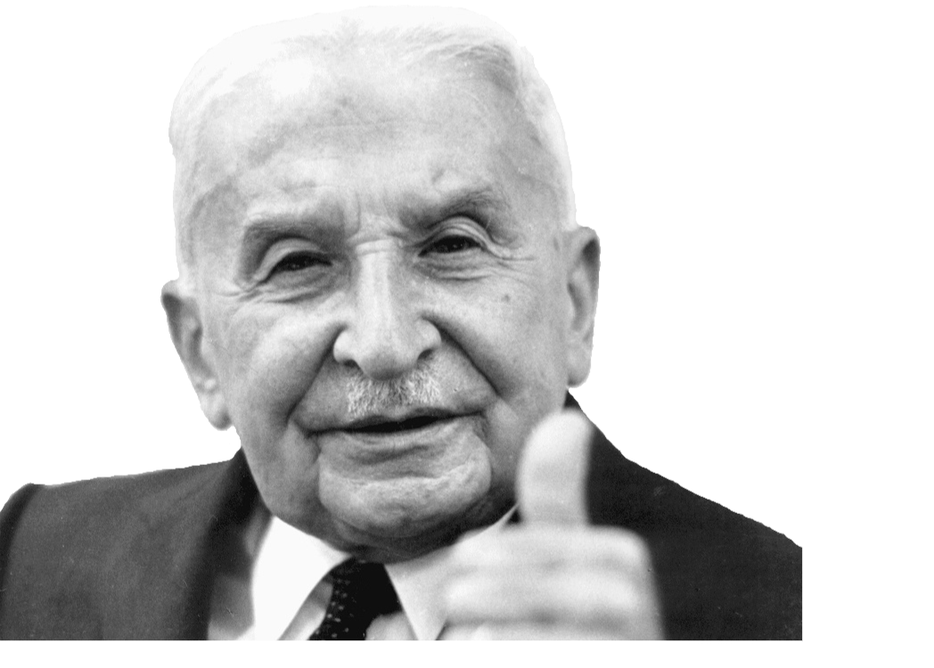
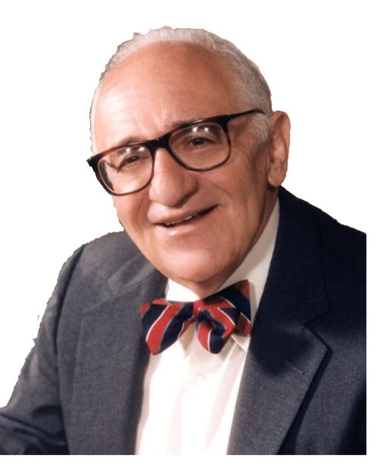
Understanding Economics
Notes:
Reece
Now, let's discuss libertarianism and its views on economics
There are many different economic philosophies, such as Classical, Keynesian, Monetarist.
Modern Libertarianism aligns itself with the economic framework of the Austrian School of economics.
This philosophy differentiates itself from others by its focus on individual action and cause and effect.
Two of the most famous economists in this philosophy were Ludwig von Mises and his pupil, Murray Rothbard.
Together Their work has had a significant impact on Libertarian philosophy

Slide 66
What is Economics?
Study of how individuals use scarce means to attain desired ends
Notes:
Reece:
To begin, we should first answer the questions, “What is Economics?”
Economics is the Study of how individuals use scarce means to attain desired ends
Scarce means refers to limited resources
Our Resources are Time, energy (which together can be Labor), and natural resources (which we often generically call Land)
Desired ends are our needs and wants
This is Anything from food and water, to a Lamborghini
When we refer to ends we really mean the satisfaction we derive from goods and services

Slide 67
What is Economics?
Unlimited needs and wants, but limited
resources → choose what ends we satisfy with our resources
Notes:
Reece:
We have unlimited needs and wants, but limited resources. Therefore, we have to choose what ends we satisfy with our resources
And economics is the study of these actions of choice

Slide 68
Voluntary Exchange
People are free to exchange any of their resources, with any other person, at any rate, so long as both individuals agree and there is no use of force or threat of violence
Both are better off, value created!
Notes:
Reece:
As libertarians, we oppose aggression, therefore, the only economic system we support is voluntary exchange.
This means People are free to exchange any of their resources, with any other person, at any rate (this would be Price), so long as both individuals agree and there is no use of force or threat of violence
Under this system BOTH individuals benefit from the exchange, if one did not, then the exchange would not happen
Both individuals are winners, there are no losers.
This exchange creates value, as both individuals feel they are richer, since they now have a resource they prefer more than the one they just exchanged.
It is through voluntary exchange that value is created in an economy.
An economy where ALL exchanges are voluntary is a free market economy.
An economy where all exchanges are involuntary is a planned economy
An economy where some exchanges are voluntary and some are involuntary is a mixed economy
And Of course, these exist on a spectrum
Often, people will call a free market economy “Capitalism”
However, I try not to use the word capitalism
This term was coined by Karl Marx as a smear against the free market
As well, when people critique “Capitalism,” they are referring to a mixed economy, whos governance has been captured by businesses in an unholy alliance with the political class
And every problem they point out is a result of this alliance, or worsened because of it
Because of this, I do not advocate for capitalism, I advocate for the free market and voluntary exchange

Slide 69

Efficiency of Voluntary Exchange
We use our resources to satisfy the highest priority wants
Notes:
Reece:
Now, Since we have infinite wants and finite resources, we must prioritize our wants, and use our resources to satisfy the highest priority wants that we can.
Here is an example of how we might prioritize our desired ends
Under a system of voluntary exchange, we use our resources to satisfy the most important wants we can
That means we’re going to satisfy our desire for water and food before we satisfy our desire for playing cards
It would make no sense if we satisfied wants of lesser importance first
And If someone seemingly satisfies a “lesser” want, the viewer is mistaken, through their action the individual demonstrates the want they satisfied was the more valuable want.
If someone gets Uno cards before food, they must actually prefer Uno Cards to food
This is called demonstrated preference
Therefore, under voluntary exchange, resources are most “efficiently” used; they are satisfying the most important wants an individual has

Slide 70
Government Intervention
Government intervention causes an individual to take actions that satisfy lesser wants
Makes individual worse off
There is no intervention that can make us better off
Notes:
Reece:
Therefore, whenever Government intervention causes an individual to take actions they would not have otherwise, they are necessarily causing individuals to take actions that satisfy lesser wants
Imagine someone has satisfied the first three levels of the pyramid
Let's say the government bans playing cards, now, that person will get Uno instead of playing cards. They now have a lower want satisfied and are worse off
If these truly were greater wants then the individual would have taken the action without government intervention
This means that government intervention, always and everywhere, makes individuals worse off than they otherwise would be
But I would like to emphasize this point again, because it is very important
Government intervention inherently makes people worse off
It is not the case that they just happen to make us worse off.
There is no intervention that can make us better off, instead, they are going to make another individual worse off through the use of aggression.
So whenever government economists say they’re solving market inefficiencies and making everyone better off, they are wrong.

Slide 71
What is Money?
Medium of Exchange
Marketability, Divisibility, Uniformity, Durability, Transportability
Facilitates economic activity → Value created → everyone better off
Notes:
Reece:
Another important concept we need to understand is money. What is money?
Money is a medium of exchange
Imagine a barter economy, it would be hard to find an individual with exactly what you want, looking for exactly what you have to trade.
For example, If you have a cow, but you would prefer some shoes, you have to find someone who would prefer a cow over some shoes.
Because of this, you May employ a medium of exchange
You trade something you have for something you don’t want to consume, but you know others do, so you can use it to trade for what you do want to consume
For example, instead of trying to trade your cow for shoes, you trade the cow for wheat, and then trade that wheat for shoes. Here, the wheat was used as a medium of exchange
You do not consume the wheat, but rather use it to facilitate another exchange
What makes a good medium of exchange?
Marketability: if a lot of people want it you know you can get what you want by trading it.
You wouldn’t want to trade your cow for an elephant, not many people want that and you’ll have an even harder time trying to find someone to trade it with.
Divisibility: The easier it is to divide into smaller parts the better it will be as a medium of exchange. if it cannot be divided into small quantities it will be more difficult to settle on an exchange rate (also known as the Price)
You can’t divide a house up, if you want something low in value, how are you going to trade away that house? One house for a Pair of shoes?
Uniformity: For a good to be a good medium of exchange it should be uniform.
For example, one sick cow is not equal to one healthy cow. These differences in quality between units makes exchange more difficult
Durability: if it decays quickly it is harder to use as medium of exchange because as you hold it between exchanges it decreases in value
Think about Ice, after you trade your cow for ice, a lot of it will have melted, causing you to lose value, by the time you find someone selling shoes
Transportability: If you can’t get the item to where you’re going to exchange it, how are you going to exchange it?
Imagine how frustrating it would be if we conducted our exchanges with household furniture like dining room tables and sofas.
Money naturally arises in an economy as the best medium of exchange.
Throughout most of history, these were precious medals. Largely Gold, with Silver playing a secondary role. Ancient Rome also employed copper for very small transactions
Despite what the government intellectuals tell you, money did not emerge through government decree, but rather through voluntary exchange
Money Facilitates greater economic activity
And More exchanges mean more value created
Therefore, money is an instrument which facilitates value creation and helps make individuals better off.
Because of this, we must protect money from the predations of government
One example of government abuse of money is that the Federal Reserve Prints money out of thin air, inflating the money.
This monetary inflation is what causes the boom bust cycle that results in economic catastrophe every handful of years
In a free market economy there would be no boom bust cycle, or at least only a very subdued one.
The key takeaway from this is that Government intervention and meddling in the economy makes people worse off,
Next, to discuss education, is Frank

Slide 72
EDUCATION
School Choice and Market Solutions

Slide 73
The Liberty Position
Education is the sole responsibility of parents and their children.
The state should not be involved at all.
Notes:
Parents and children know what’s best for themselves and their Families
Education is not any government’s business (feds, state, local)

Slide 74

What Does it Mean?
End Tax-Funded (“Public”) Schools
Abolish the Dept of Education
A Free Market in Education Services
Notes:
Tax-funded programs use threats of violence to achieve their goals, and thus violate the rights of those taxed.
DOE is central planning of schooling for whole country - https://www2.ed.gov/about/overview/focus/what.html
Also state DOEs - https://www.education.pa.gov/about/Pages/default.aspx
Free market (Voluntary exchange) always best matches service providers with consumers (direct negotiation & exchange between the involved parties)
Also the only moral solution

Slide 75
Benefits of a Free Market in Education
VARIETY
SIMPLER
COMPETITION
School Culture
Curriculum
Schedule
Focus (arts, agriculture, engineering)
Less Bureaucracy
Lower Admin & Operating Costs
Schools Focus on Teaching
More Choices
Lower Prices
Better Teacher Pay
Weed Out Bad Teachers & Schools
Notes:
Variety:
Wide variety of school types, curricula, cultures (i.e. arts, tech, religion, Montessori, Friends)
Different students learn differently, at different speeds, and via different methods
Simpler:
Eliminate DOE, state Depts too
Admins don't have to engage w/ bureaucracies
Schools don't have to teach to tests
Competition
Between the schools for both students ($) and teachers
Schools trying to provide the best service for lowest price to attract the most students & tuition
Good teachers are an Asset & valued by schools
Bad teachers & Schools that don’t perform will not be valued by customers & will go away
- like a restaurant w/ bad food - no one wants to work there & no one goes there, so it goes under

Slide 76
What Does it Look Like?

Slide 77

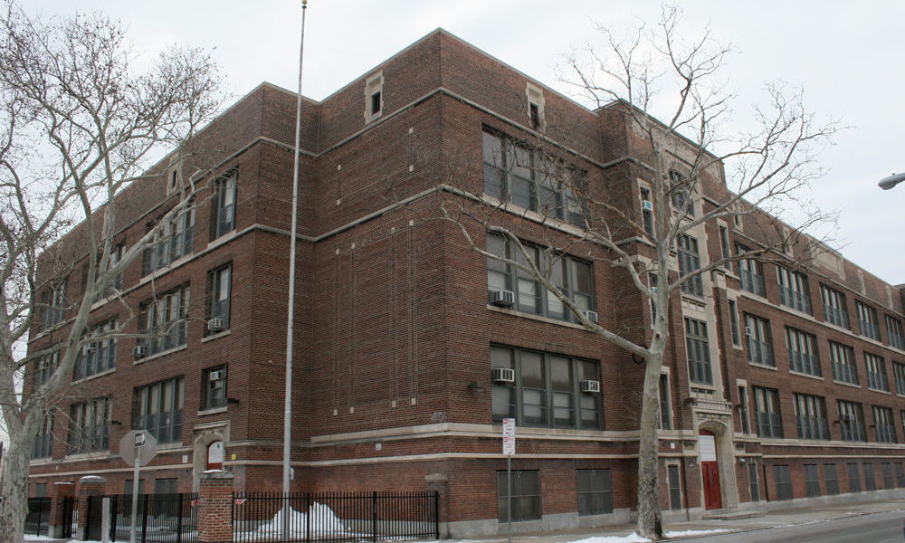
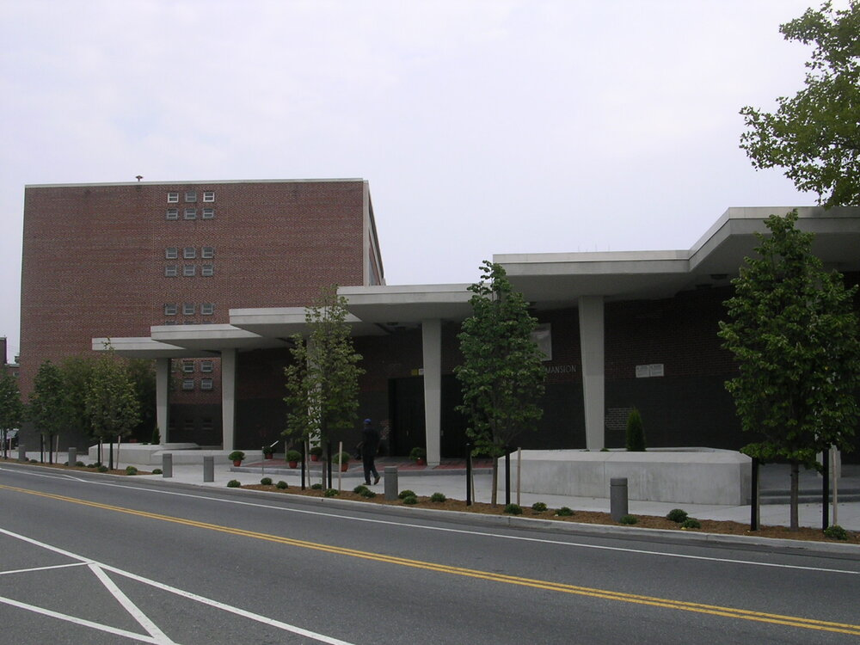
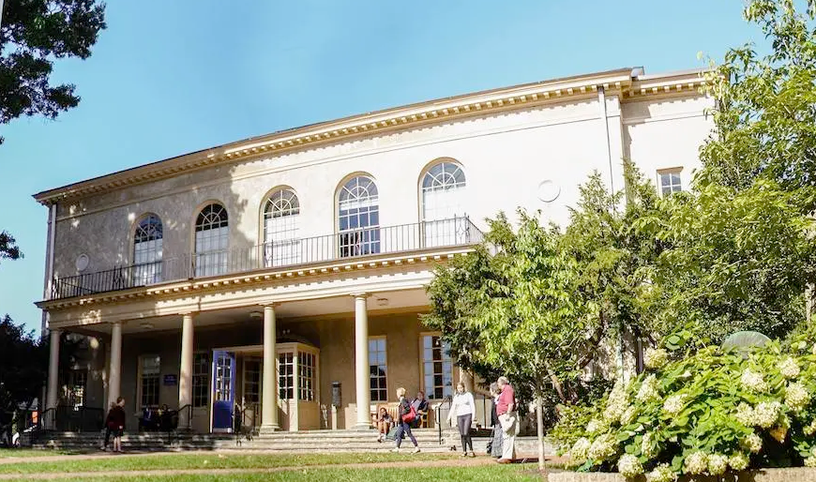
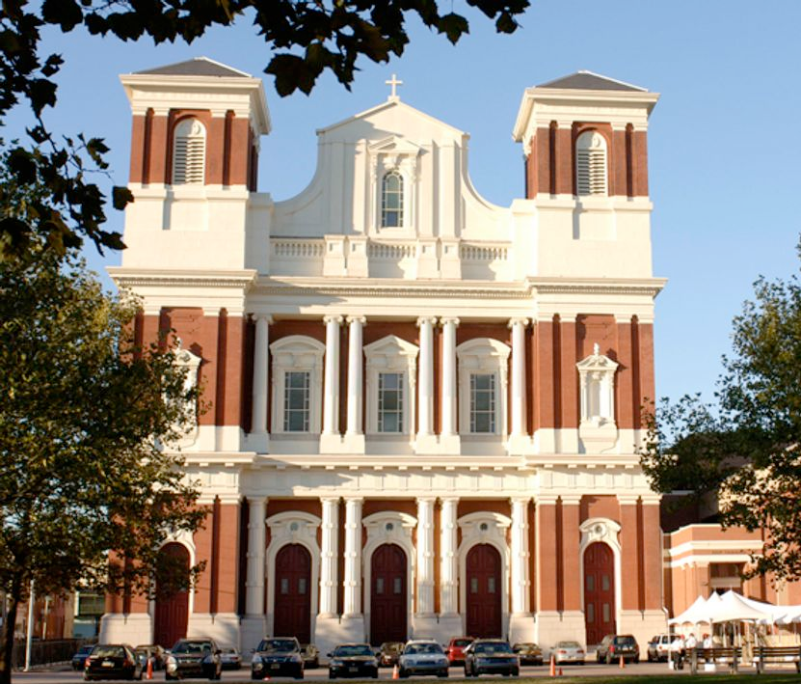
The Liberty Ideal
Families
Kids Attend
Tuition $
Tuition $
Schools

Slide 78
Where Are We Today?

Slide 79

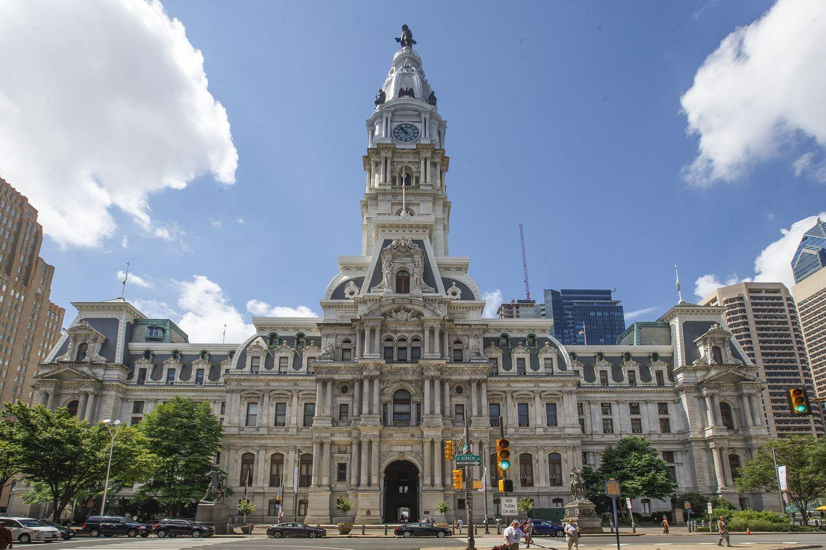
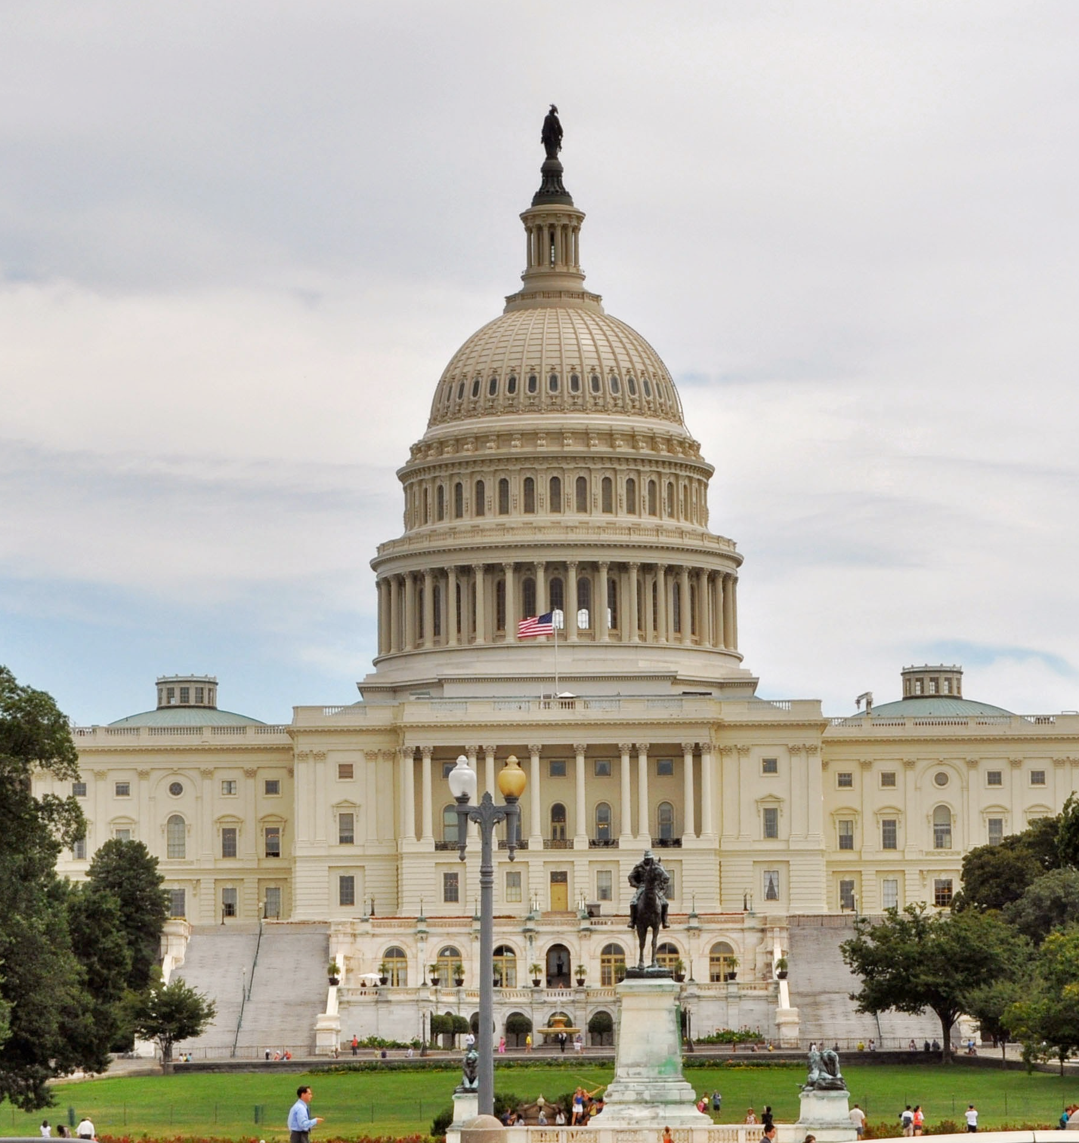


The Problem Today: The American Public School System
Taxpayers
Tax $
Tax $
Kids
DC
Local
State
Standard
Curricula
Standard
Curricula
Attend
Enforce
Administration
Public Schools

Slide 80
An Option for Some: American Private Schools
Parents who
can afford
Taxpayers
What about these kids??
Tax $
Tax $
Kids
DC
Local
State
Standard
Curricula
Standard
Curricula
Extra $
Attend
Attend
Administration
Private School

Slide 81
How Can We Make it Better?
School Choice: Moving in the Right Direction

Slide 82
District Choice
Parents can apply for kids to attend any school in the district
Still subject to availability (i.e. Philly today)
Has side-effects like high rents/property values in catchments w/ good schools (i.e. Penn Alexander, Masterman)

Slide 83
Charter Schools
Still public & tuition-free
Curriculum, culture, discipline, etc. can differ from district standards
Often focus on specific subjects, i.e. STEM, theatre, agriculture
Regulated by state/local via a “charter” agreement
Notes:
Still Tax Funded
Variety of experience, but not complete freedom
Charter still gives state/city/district control

Slide 84
“Backpack Funding”: ESA & Vouchers
Tax $ for each student goes to a special Education Savings Account (ESA) or is reserved by the state for the school the student chooses (voucher)
Parents use ESA $ or voucher to send kids to any school, including private schools
Or homeschooling, with ESA!
Notes:
Backpack funding, specifically ESAs, was part of gov Shapiro’s platform when he was elected last year (2022), and passed the PA house and senate this summer but was vetoed

Slide 85
A Vast Improvement: Backpack Funding
Achieves variety & competition, but is not simple
Taxpayers
Tax $
Kids
$
$
Education Savings Accounts
(one per student)
DC, State & Local
$
PA
Attend
$
$
Public Schools
Private Schools

Slide 86
Conclusion
Abolish the Dept of Education!
End Tax Funding of Schools!
Vouchers & ESAs are a massive improvement!
https://www.inquirer.com/politics/pennsylvania/shapiro-vouchers-choice-school-20230630.html
Notes:
The Libertarian ideal: entirely Free Market in education, absent DoE and Tax Funded ”public” schools entirely
Tax Funding violates nonaggression and must be ended.
Vouchers & ESA’s are a tremendous step in the right direction, and have real momentum in Pennsylvania

Slide 87
Thank You!

